Slide 1
Astro 331
Structures & Mechanisms
SMAD Ch 11.6

Slide 2
Lesson Objectives
Explain spacecraft structures and mechanisms functions
Describe the various types of loading conditions that happen during launch and ascent
Identify common characteristics used when selecting materials for spacecraft structures and mechanisms
Analyze monocoque cylinder structures with respect to natural frequency, strength, and buckling
Understand some of the challenges of designing mechanisms for spacecraft

Slide 3
Structures & Mechanisms Functions
Mechanically support all other S/C subsystems
Survive all loading conditions
Not just launch, but also during assembly, test, transport to launch site, as well as operations (deployment of mechanisms, etc)
Attach S/C to L/V
Provide for ordnance-activated separation

Slide 4
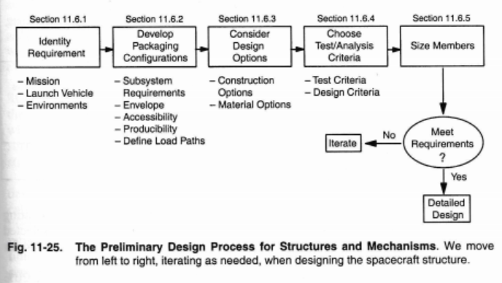
Preliminary Design Process

Slide 5
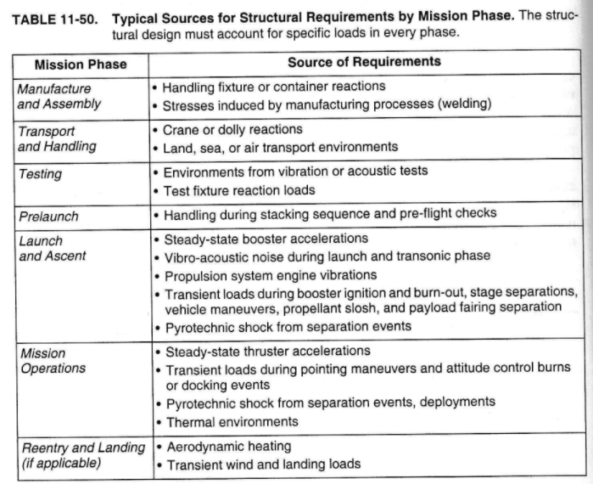

Slide 6
Loading Conditions During Launch & Ascent
Resonance: Launch vehicle’s natural frequencies can respond to forces from internal (engine oscillations) and external (aerodynamic effects) sources
Potential sources of resonance: oscillations in the propulsion system (pogo), aerodynamic buffering during ascent, bending of solid rocket motors
Axial, bending, and torsional modes
Load factors (multiples of weight at sea level): Acceleration from rocket thrust, as well as wind gust and vehicle maneuvers, impart loads
Random vibration: caused by acoustic noise from launch and aerodynamic turbulence during ascent
Pyrotechnic shock: comes from explosive separation events like separation from launch vehicle

Slide 7
How do we model all of these loading conditions?
Combine math models of the spacecraft and launch vehicle to do what’s called a coupled loads analysis
Drive the coupled model (S/C + L/V) with forcing functions that are based on measured launch vehicle environments

Slide 8
Materials Selection (1/2)
Material that an object is made out of will determine its response to various loading conditions
Typical S/C has both metallic and nonmetallic materials
Metals: homogenous (constant properties) and isotropic (same properties regardless of direction of loading)
Nonmetals: composite materials – not homogenous and often not isotropic

Slide 9
Materials Selection (2/2)
Materials are selected based on the following properties:
Strength
Stiffness
Density (related to weight)
Thermal conductivity
Corrosion resistance
Cost
Ductility
Fracture toughness
Ease of fabrication
Versatility of attachment options
Availability

Slide 10
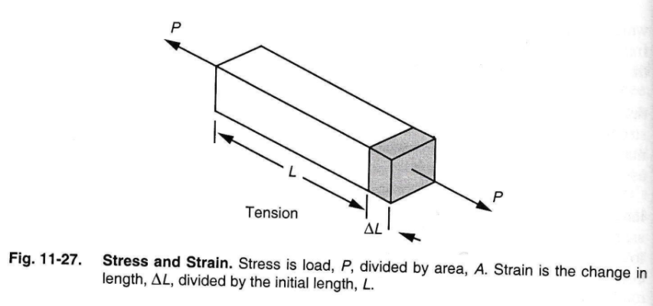
Stress and Strain

Slide 11
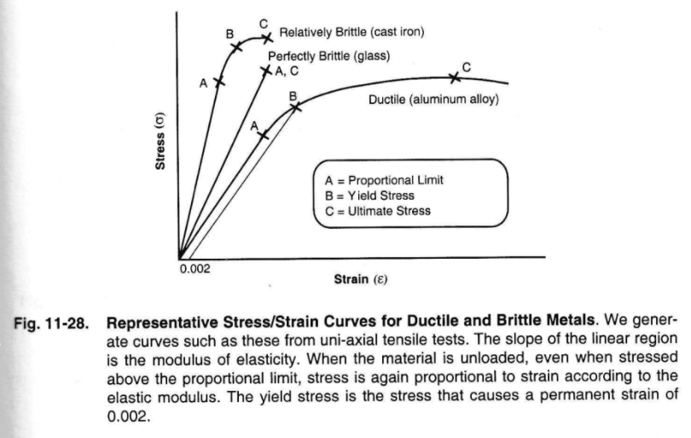
Stress/Strain Curve

Slide 12
Stress/Strain Curve (Explained)
Elastic (linear) region is where a material will return to its original length after a stress
Until Point A
Beyond a stress called the proportional limit, the material’s stress-strain curve is no longer linear (inelastic)
Between points A and B
Beyond the proportional limit, the material will undergo residual strain
Between points B and C
Finally, there is a yield point where a material will rupture (Ultimate Failure)
Point C

Slide 13
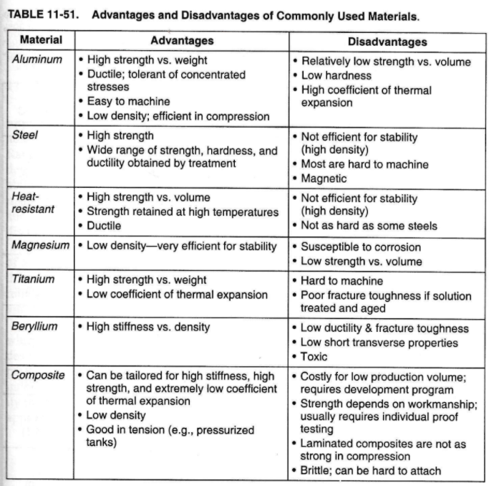

Slide 14
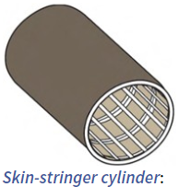
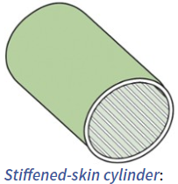
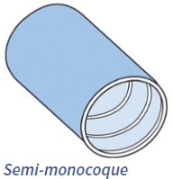
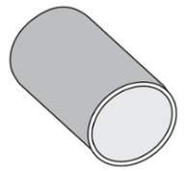
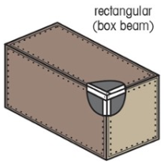
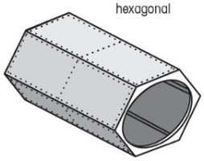
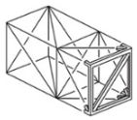
Cylinder, Skin-Frame, & Truss Structures
Adapted from Designing Space Missions and Systems, Tables 11.45 through 11.48

Slide 15
Cylindrical Structures
Monocoque cylinder (soda can)
shell without stiffeners or ring frames
strength limited by its buckling stress
difficult to mount components w/o overloading the shell
may require access panels
Skin-stringer cylinder
skin designed to buckle at low loads
stringers carry most of axial load and bending moment
Stiffened-skin cylinder
thin skin and lightweight
closely-spaced stiffeners to increase skin’s buckling stress
Semi-monocoque cylinder
intermediate ring frames to increase skin’s buckling stress
no axial stiffeners or stringers
may require access panels
stringers provide hard points for introducing loads

Slide 16
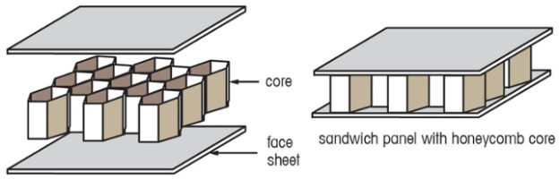
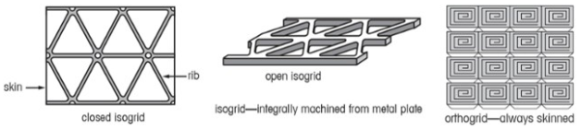
Sandwich, Isogrid, & Orthogrid Structures
Adapted from Designing Space Missions and Systems, Tables 11.49 & 11.50

Slide 17
Other Structures (1/2)
Skin-frame structures
skin surrounding a skeletal framework
to be stable, ends of skin-stringer structure must be closed with skin, be “triangularized” with diagonal members, or include radially deep frames (as in hexagonal figure)
sandwich and isogrid panels can be used to mount components
versatile regarding shape
Truss construction
withstands loads applied to its joints w/members loaded only axially
fabrication
extruded tubes or open shapes
truss sides integrally machined from plate –stock matl
laminated composite tubes w/metallic end fittings
S/C components mounted internally or externally
can be difficult to transfer loads from truss to cylindrical structure
most efficient for square, rectangular or triangular cross section structures (less efficient as cross section becomes more round

Slide 18
Other Structures (2/2)
Sandwich construction
high in-plane bending stiffness and low mass
weak in the out-of-plane direction
often must reinforce sandwich around local areas of attachment (brackets, metal inserts)
honeycomb core must be vented (small perforations btw cells)
Isogrid and orthogrid
light-weight plates w/high bending strength and stiffness and shells w/high buckling strength
peg-board-like grid (at all rib intersection locations) for attachment points
fabrication
isogrid with or without skin
orthogrid always with skin
isogrid is virtually isotropic but orthogrid is not

Slide 19
Modeling Monocoque Structures
Look at three loading conditions
Resonance (natural frequency)
Goal: want our spacecraft to have a higher natural frequency than launch vehicle
Strength
Goal: cylinder must be strong enough to tolerate design load limit factors
Buckling
Goal: want the calculated stress due to buckling (stress at which material will buckle) to be greater than the equivalent ultimate stress (expected stress due to loading conditions)

Slide 20
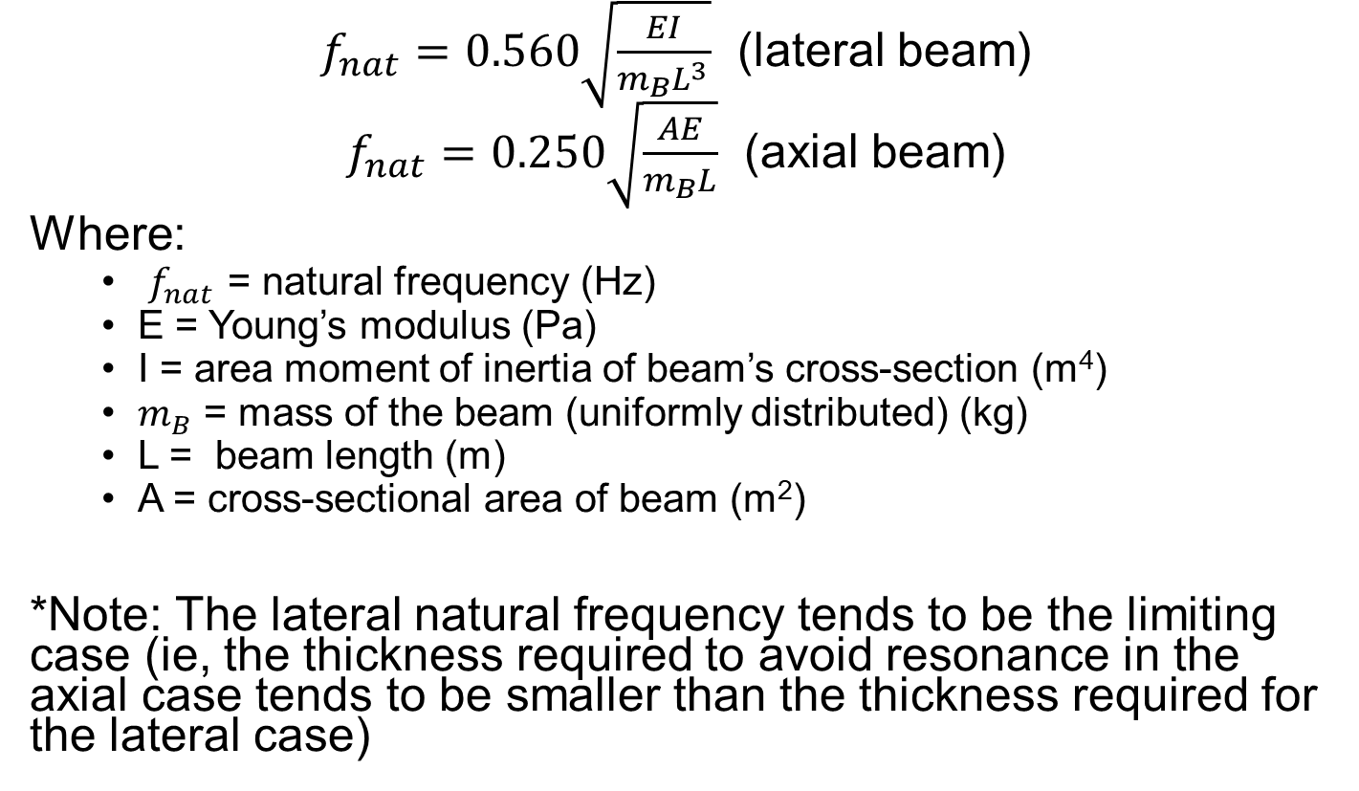
Natural Frequency (1/2)
$f_{nat}=0.560\sqrt{\frac{EI}{m_{B}L^{3}}}$ (lateral beam)
$f_{nat}=0.250\sqrt{\frac{AE}{m_{B}L}}$ (axial beam)
Where:
$f_{nat}$ = natural frequency (Hz)
E = Young’s modulus (Pa)
I = area moment of inertia of beam’s cross-section (m⁴)
$m_{B}$ = mass of the beam (uniformly distributed) (kg)
L = beam length (m)
A = cross-sectional area of beam (m²)
*Note: The lateral natural frequency tends to be the limiting case (ie, the thickness required to avoid resonance in the axial case tends to be smaller than the thickness required for the lateral case)

Slide 21
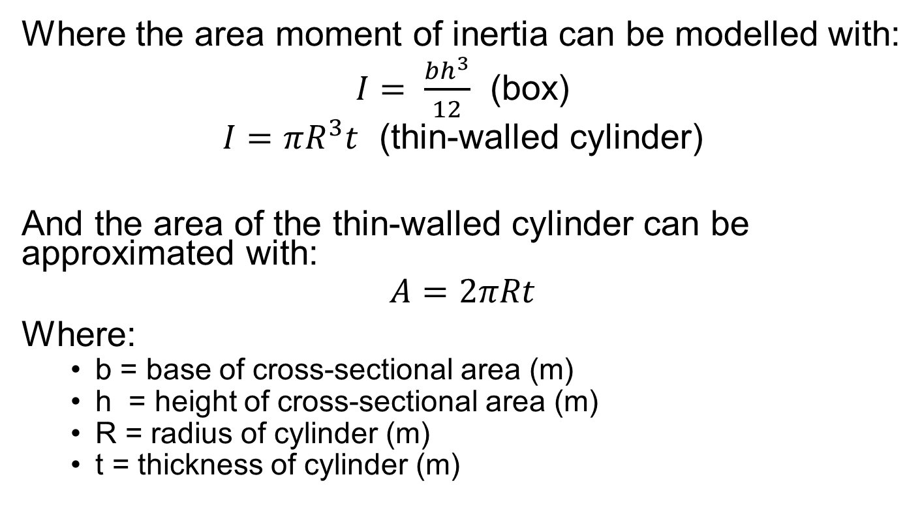
Natural Frequency (2/2)
Where the area moment of inertia can be modelled with:
$I= \frac{bh^{3}}{12}$ (box)
$I=πR^{3}t$ (thin-walled cylinder)
And the area of the thin-walled cylinder can be approximated with:
$$A=2πRt$$
Where:
b = base of cross-sectional area (m)
h = height of cross-sectional area (m)
R = radius of cylinder (m)
t = thickness of cylinder (m)

Slide 22
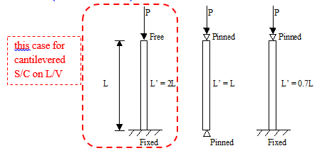
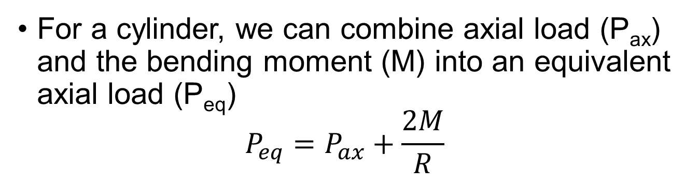
Strength (1/2)
For a cylinder, we can combine axial load (P_{ax}) and the bending moment (M) into an equivalent axial load (P_{eq})
$$P_{eq}=P_{ax}+\frac{2M}{R}$$

Slide 23
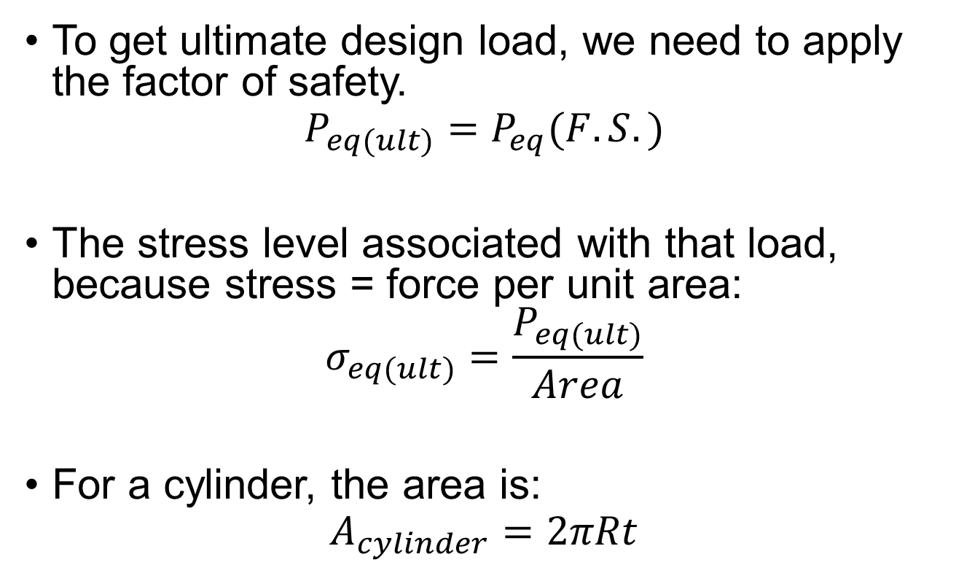
Strength (2/2)
To get ultimate design load, we need to apply the factor of safety.
$$P_{eq(ult)}=P_{eq}(F.S.)$$
The stress level associated with that load, because stress = force per unit area:
$$σ_{eq(ult)}=\frac{P_{eq(ult)}}{Area}$$
For a cylinder, the area is:
$$A_{cylinder}=2πRt$$

Slide 24
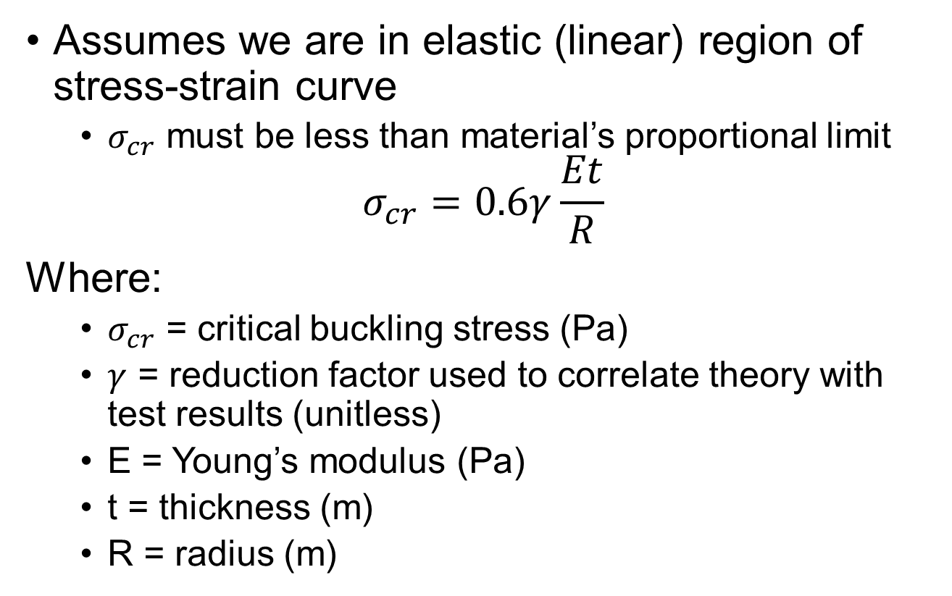
Buckling (1/2)
Assumes we are in elastic (linear) region of stress-strain curve
$σ_{cr}$ must be less than material’s proportional limit
$$σ_{cr}=0.6γ\frac{Et}{R}$$
Where:
$σ_{cr}$ = critical buckling stress (Pa)
$γ$ = reduction factor used to correlate theory with test results (unitless)
E = Young’s modulus (Pa)
t = thickness (m)
R = radius (m)

Slide 25
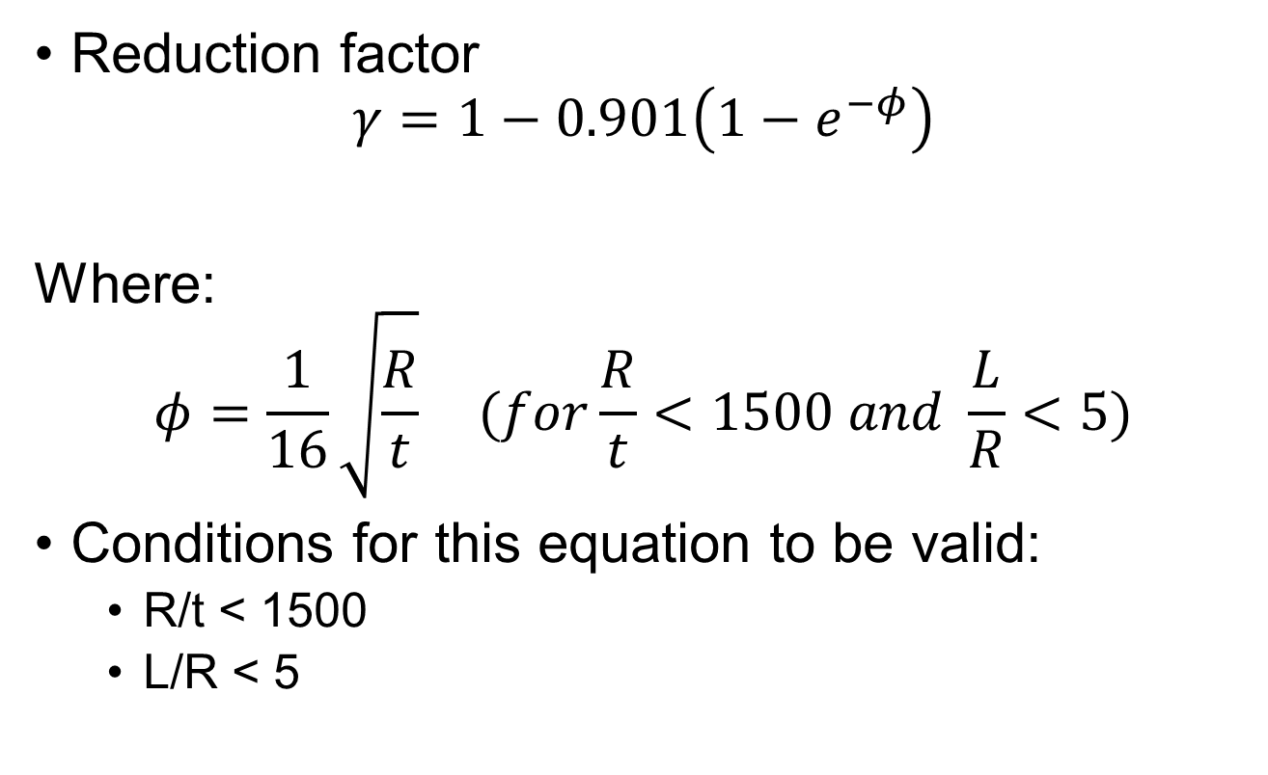
Buckling (2/2)
Reduction factor
$$γ=1−0.901\left(1−e^{−φ}\right)$$
Where:
$$φ=\frac{1}{16}\sqrt{\frac{R}{t}} (for\frac{R}{t}<1500 and \frac{L}{R}<5)$$
Conditions for this equation to be valid:
R/t < 1500
L/R < 5

Slide 26
Mechanisms
Mechanism: moving mechanical assembly
Two categories:
High-cyclic: must move many times during mission
Low-cyclic: moves only once or a small # of times
Design challenges:
Thermal expansion/contraction due to changing temperatures on spacecraft
Inducing vibration to spacecraft
Friction within mechanism
Failure due to repeated use
Harness routing without causing wire damage

Slide 27
Mechanism Uses
High-cyclic:
Antenna pointing & tracking
Solar array pointing & tracking (for sun-tracking arrays)
Attitude control (reaction wheels or CMGs)
Switches within TT&C subsystem
Low-cyclic:
Antenna on-orbit deployment
Solar array on-orbit deployment
S/C - L/V separation

Slide 28
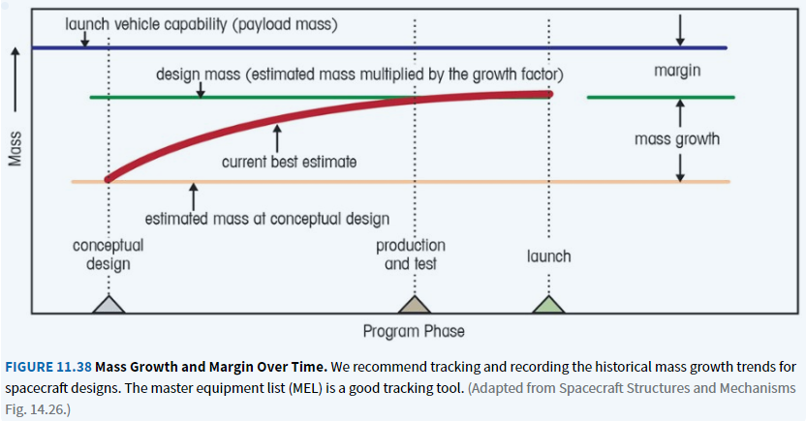
Mass Growth
Designing Space Missions and Systems, Fig 11.38

Slide 29
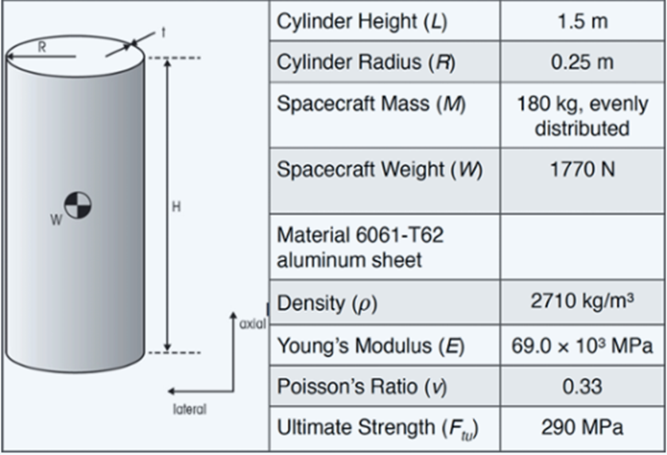
Given:
1st lateral fundamental frequency ≥ 35 Hz
Design limit load factors for sizing primary structure
Axial = 6 g’s
Lateral = 1.5 g’s
Ultimate factor of safety FS_{ult} = 1.25
Yield factor of safety FS_{yield} = 1.1
Find:
Minimum cylinder thickness to account for natural frequency, strength, and buckling
0.35 m
(σ_{u})
Yield Stress (σ_{y})
240 MPa

Slide 30
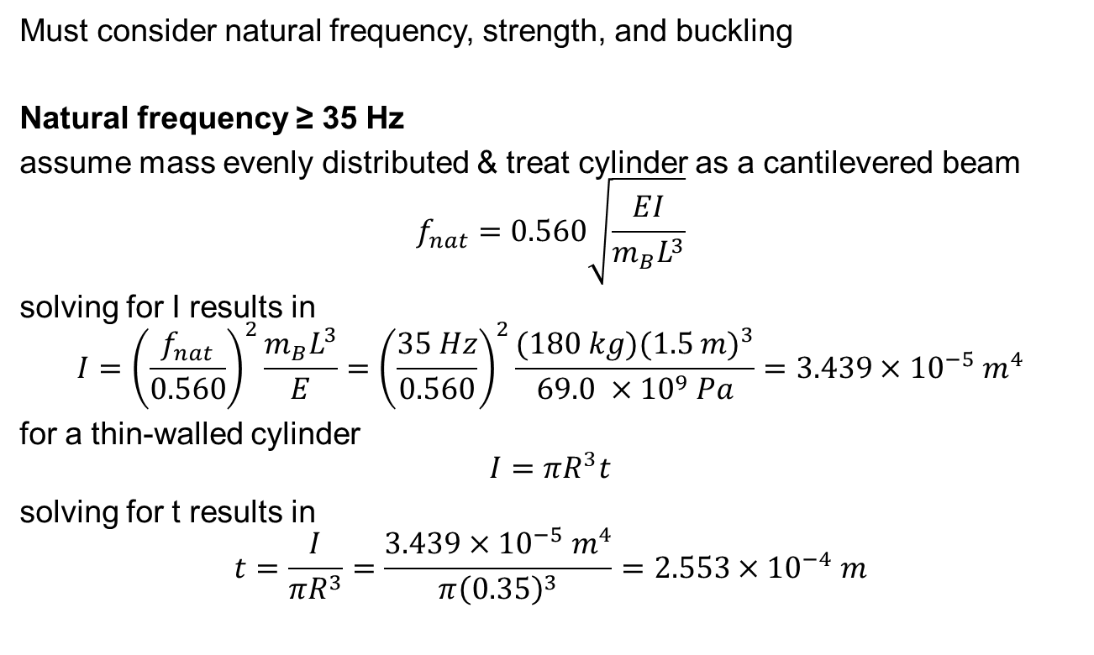
Solution (1/5)
Must consider natural frequency, strength, and buckling
Natural frequency ≥ 35 Hz
assume mass evenly distributed & treat cylinder as a cantilevered beam
$$f_{nat}=0.560\sqrt{\frac{EI}{m_{B}L^{3}}}$$
solving for I results in
$$I={\left(\frac{f_{nat}}{0.560}\right)}^{2}\frac{m_{B}L^{3}}{E}={\left(\frac{35 Hz}{0.560}\right)}^{2}\frac{(180 kg){(1.5 m)}^{3}}{69.0 ×{10}^{9} Pa}=3.439×{10}^{−5} m^{4}$$
for a thin-walled cylinder
$$I=πR^{3}t$$
solving for t results in
$$t=\frac{I}{πR^{3}}=\frac{3.439×{10}^{−5} m^{4}}{π{\left(0.35\right)}^{3}}=2.553×{10}^{−4} m$$

Slide 31
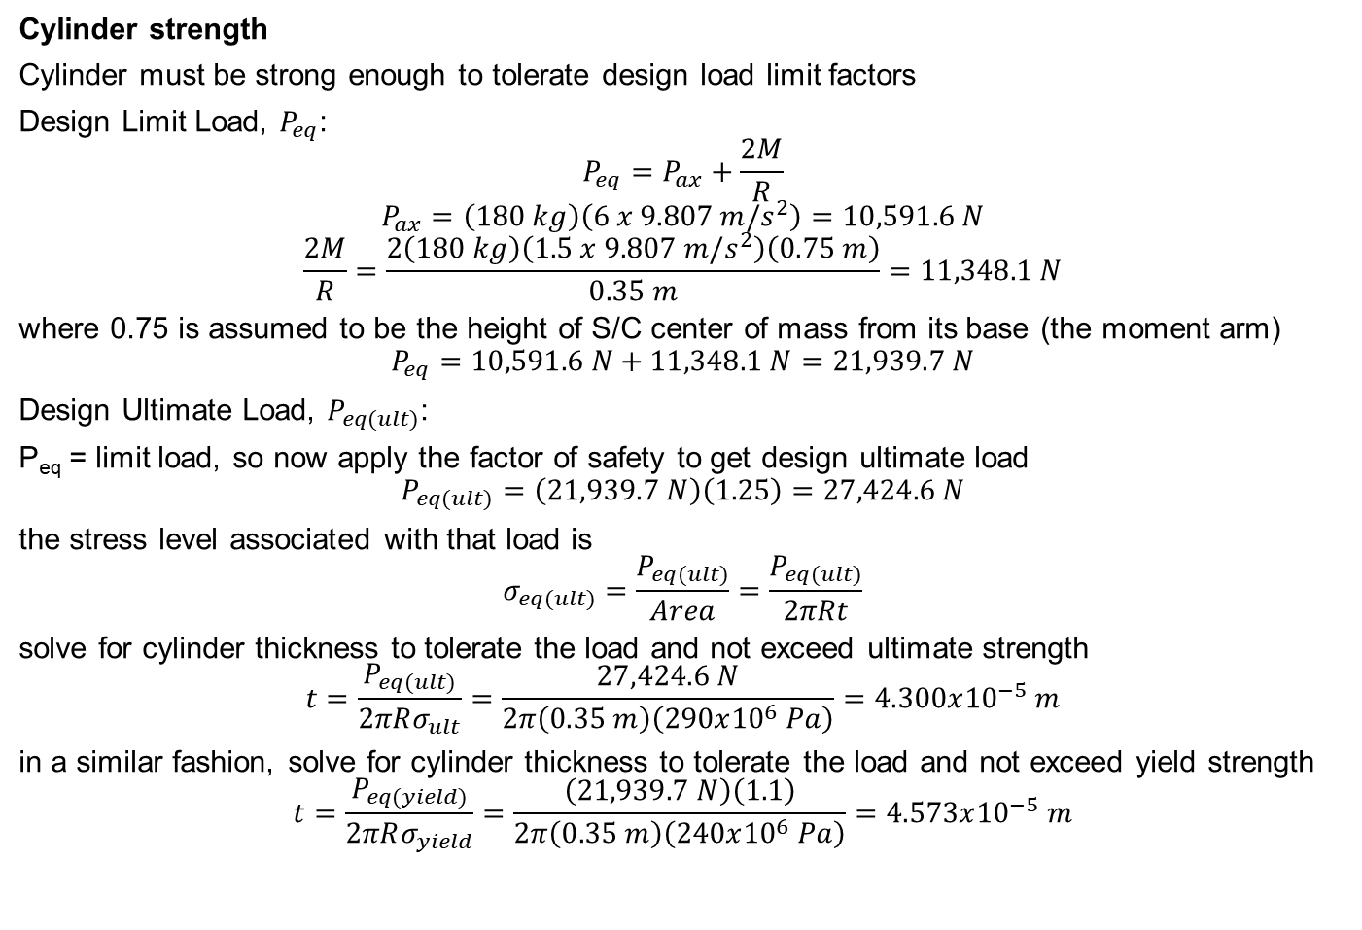
Solution (2/5)
Cylinder strength
Cylinder must be strong enough to tolerate design load limit factors
Design Limit Load, $P_{eq}$:
$$P_{eq}=P_{ax}+\frac{2M}{R}$$
$$P_{ax}=\left(180 kg\right)\left(6 x 9.807 m/s^{2}\right)=10,591.6 N$$
$$\frac{2M}{R}=\frac{2\left(180 kg\right)\left(1.5 x 9.807 m/s^{2}\right)\left(0.75 m\right)}{0.35 m}=11,348.1 N$$
where 0.75 is assumed to be the height of S/C center of mass from its base (the moment arm)
$$P_{eq}=10,591.6 N+11,348.1 N=21,939.7 N$$
Design Ultimate Load, $P_{eq(ult)}$:
P_{eq} = limit load, so now apply the factor of safety to get design ultimate load
$$P_{eq(ult)}=\left(21,939.7 N\right)\left(1.25\right)=27,424.6 N$$
the stress level associated with that load is
$$σ_{eq(ult)}=\frac{P_{eq(ult)}}{Area}=\frac{P_{eq(ult)}}{2πRt}$$
solve for cylinder thickness to tolerate the load and not exceed ultimate strength
$$t=\frac{P_{eq(ult)}}{2πRσ_{ult}}=\frac{27,424.6 N}{2π\left(0.35 m\right)\left(290x{10}^{6} Pa\right)}=4.300x{10}^{−5} m$$
in a similar fashion, solve for cylinder thickness to tolerate the load and not exceed yield strength
$$t=\frac{P_{eq(yield)}}{2πRσ_{yield}}=\frac{\left(21,939.7 N\right)\left(1.1\right)}{2π\left(0.35 m\right)\left(240x{10}^{6} Pa\right)}=4.573x{10}^{−5} m$$

Slide 32
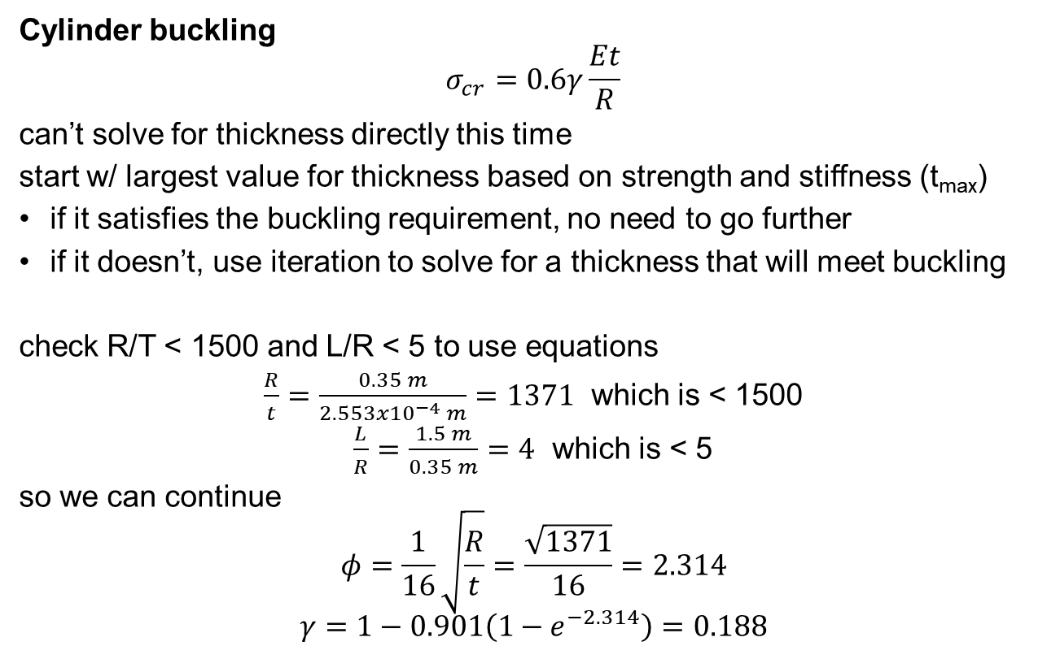
Solution (3/5)
Cylinder buckling
$$σ_{cr}=0.6γ\frac{Et}{R}$$
can’t solve for thickness directly this time
start w/ largest value for thickness based on strength and stiffness (t_{max})
if it satisfies the buckling requirement, no need to go further
if it doesn’t, use iteration to solve for a thickness that will meet buckling
check R/T < 1500 and L/R < 5 to use equations
$\frac{R}{t}=\frac{0.35 m}{2.553x{10}^{−4} m}=1371$ which is < 1500
$\frac{L}{R}=\frac{1.5 m}{0.35 m}=4$ which is < 5
so we can continue
$$φ=\frac{1}{16}\sqrt{\frac{R}{t}}=\frac{\sqrt{1371}}{16}=2.314$$
$$γ=1−0.901\left(1−e^{−2.314}\right)=0.188$$

Slide 33
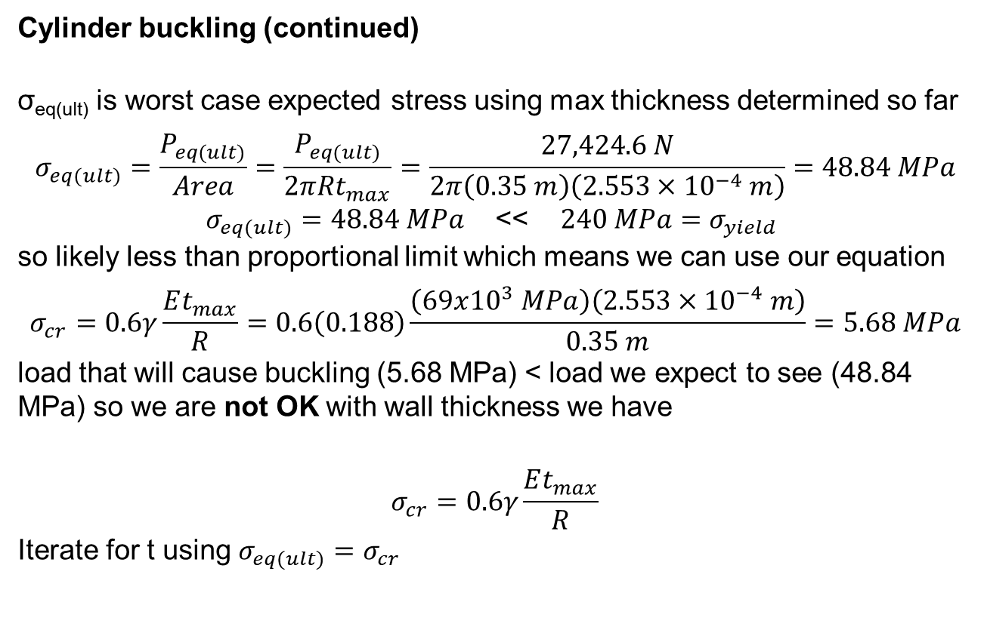
Solution (4/5)
Cylinder buckling (continued)
σ_{eq(ult)} is worst case expected stress using max thickness determined so far
$$σ_{eq(ult)}=\frac{P_{eq(ult)}}{Area}=\frac{P_{eq(ult)}}{2πRt_{max}}=\frac{27,424.6 N}{2π\left(0.35 m\right)\left(2.553×{10}^{−4} m\right)}=48.84 MPa$$
$σ_{eq(ult)}=48.84 MPa$ << $240 MPa=σ_{yield}$
so likely less than proportional limit which means we can use our equation
$$σ_{cr}=0.6γ\frac{Et_{max}}{R}=0.6\left(0.188\right)\frac{\left(69x{10}^{3} MPa\right)\left(2.553×{10}^{−4} m\right)}{0.35 m}=5.68 MPa$$
load that will cause buckling (5.68 MPa) < load we expect to see (48.84 MPa) so we are not OK with wall thickness we have
$$σ_{cr}=0.6γ\frac{Et_{max}}{R}$$
Iterate for t using $σ_{eq(ult)}=σ_{cr}$

Slide 34
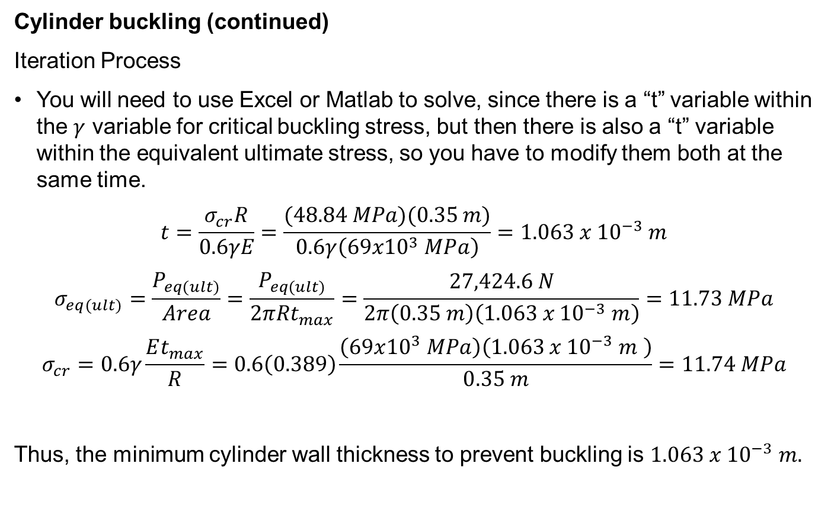
Solution (5/5)
Cylinder buckling (continued)
Iteration Process
You will need to use Excel or Matlab to solve, since there is a “t” variable within the $γ$ variable for critical buckling stress, but then there is also a “t” variable within the equivalent ultimate stress, so you have to modify them both at the same time.
$$t=\frac{σ_{cr}R}{0.6γE}=\frac{(48.84 MPa)(0.35 m)}{0.6γ\left(69x{10}^{3} MPa\right)}=1.063 x {10}^{−3} m$$
$$σ_{eq(ult)}=\frac{P_{eq(ult)}}{Area}=\frac{P_{eq(ult)}}{2πRt_{max}}=\frac{27,424.6 N}{2π\left(0.35 m\right)\left(1.063 x {10}^{−3} m\right)}=11.73 MPa$$
$$σ_{cr}=0.6γ\frac{Et_{max}}{R}=0.6\left(0.389\right)\frac{\left(69x{10}^{3} MPa\right)\left(1.063 x {10}^{−3} m \right)}{0.35 m}=11.74 MPa$$
Thus, the minimum cylinder wall thickness to prevent buckling is $1.063 x {10}^{−3} m.$

Slide 35
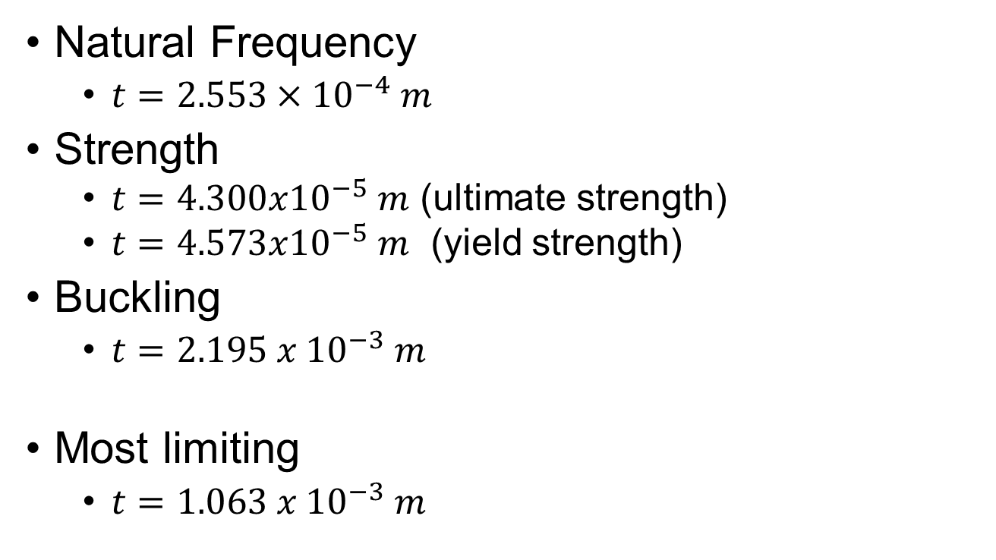
Answer
Natural Frequency
$t=2.553×{10}^{−4} m$
Strength
$t=4.300x{10}^{−5} m$ (ultimate strength)
$t=4.573x{10}^{−5} m$ (yield strength)
Buckling
$t=2.195 x {10}^{−3} m$
Most limiting
$t=1.063 x {10}^{−3} m$

